Slide 1

WEEK 10
Instructor: Yanan Wu
TA: Khadija Nisar
Spring 2025

Slide 2
7.1 Principal Component Analysis (PCA)

Slide 3
What is PCA and Why Use It?
Having too many features in data can cause problems like overfitting (good on training data but poor on new data), slower computation, and lower accuracy. This is called the curse of dimensionality, where more features exponentially increase the data needed for reliable results.
One of the most widely used dimensionality reduction techniques is Principal Component Analysis (PCA)
Key Benefits of PCA
Simplification: You transform many correlated variables into a smaller set of uncorrelated variables called principal components.
Visual Exploration: Plotting the first few principal components often helps reveal clusters or trends in data that might be less obvious in the original variables.
Noise Reduction: By focusing on components that explain the majority of variance, PCA can reduce noise from less informative variables.

Slide 4
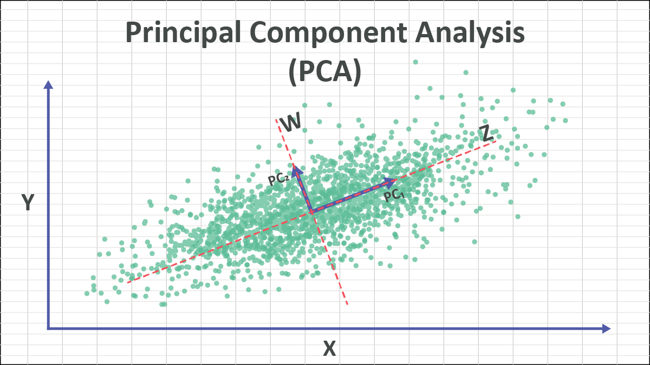
Core Ideas Behind PCA
Variance and Information: PCA assumes that the “importance” of a variable is reflected by its variance.
The more variance a direction in the data has, the more information it holds.
Principal Components: These are new variables (linear combinations of the original variables) chosen to capture maximum variance in the data.
First Principal Component (PC1): The direction in which the data vary the most.
Second Principal Component (PC2): The direction, uncorrelated with the first, that captures the most remaining variance.
This process continues until you have as many principal components as original variables.
Orthogonality: Principal components are orthogonal (uncorrelated) to each other, ensuring each component describes a new “direction” of variance not captured by previous components.

Slide 5
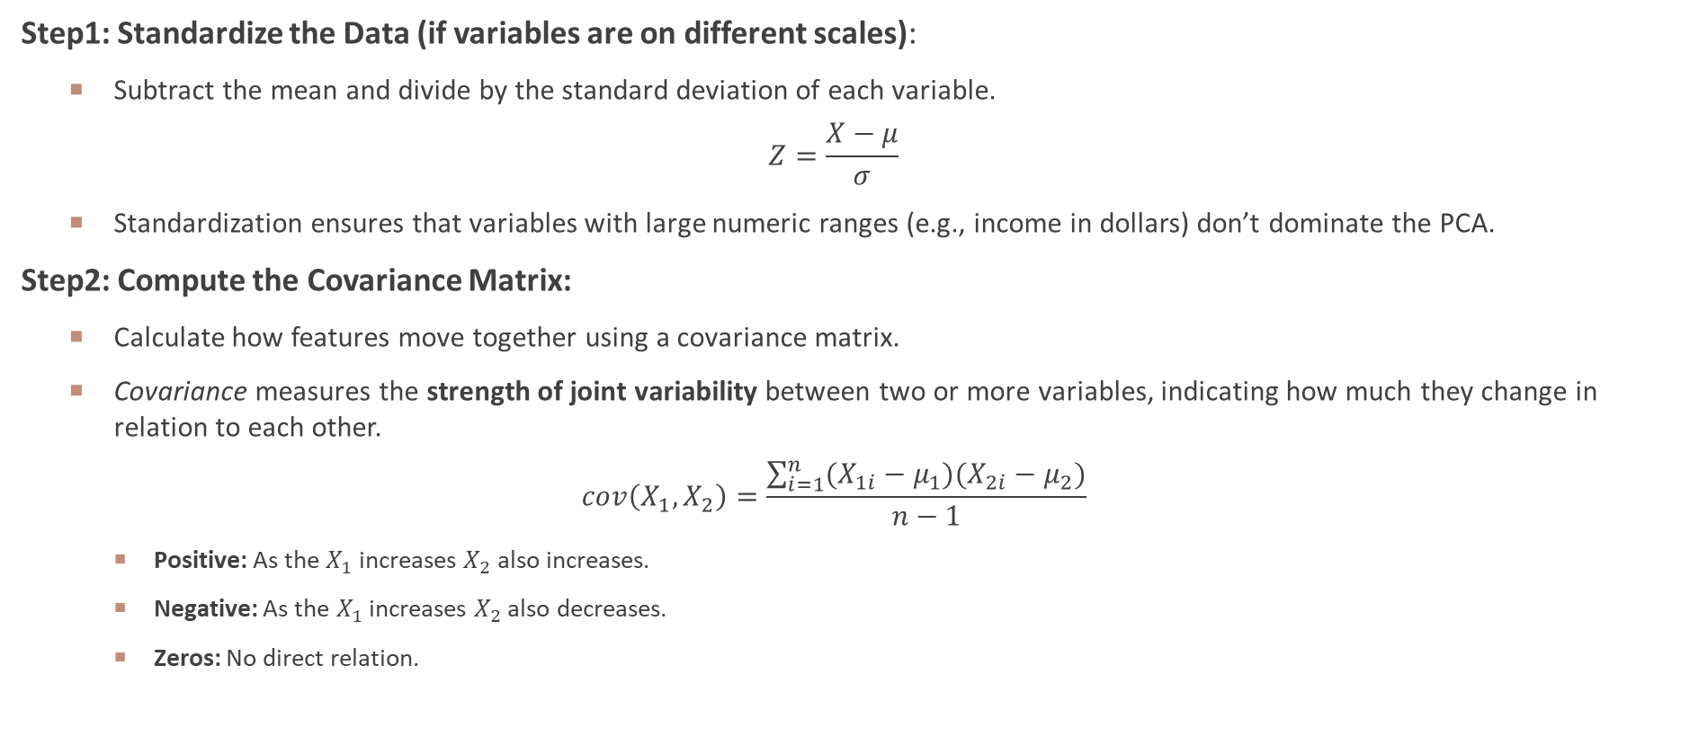
Step-by-Step PCA (Conceptual Outline)
Step1: Standardize the Data (if variables are on different scales):
Subtract the mean and divide by the standard deviation of each variable.
$$Z=\frac{X−μ}{σ}$$
Standardization ensures that variables with large numeric ranges (e.g., income in dollars) don’t dominate the PCA.
Step2: Compute the Covariance Matrix:
Calculate how features move together using a covariance matrix.
Covariance measures the strength of joint variability between two or more variables, indicating how much they change in relation to each other.
$$cov\left(X_{1},X_{2}\right)=\frac{\sum_{i=1}^{n}{(X_{1i}−μ_{1})(X_{2i}−μ_{2})}}{n−1}$$
Positive: As the $X_{1}$ increases $X_{2}$ also increases.
Negative: As the $X_{1}$ increases $X_{2}$ also decreases.
Zeros: No direct relation.

Slide 6
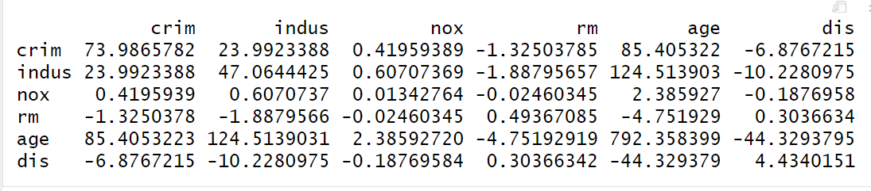
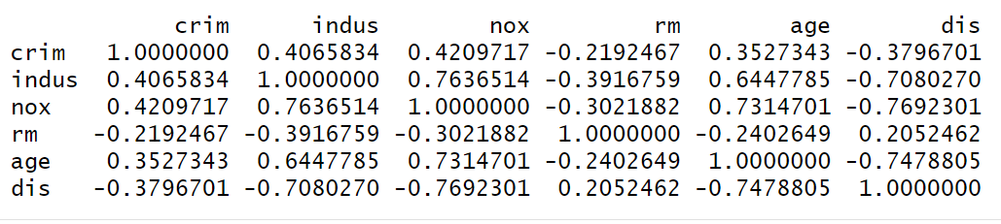
Covariance matrix
Data: Boston data in MASS Packages
Covariance for non-standardized variables
Covariance for standardized variables

Slide 7
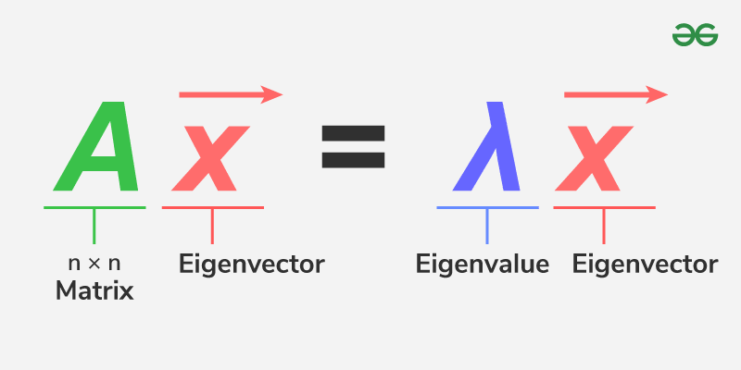
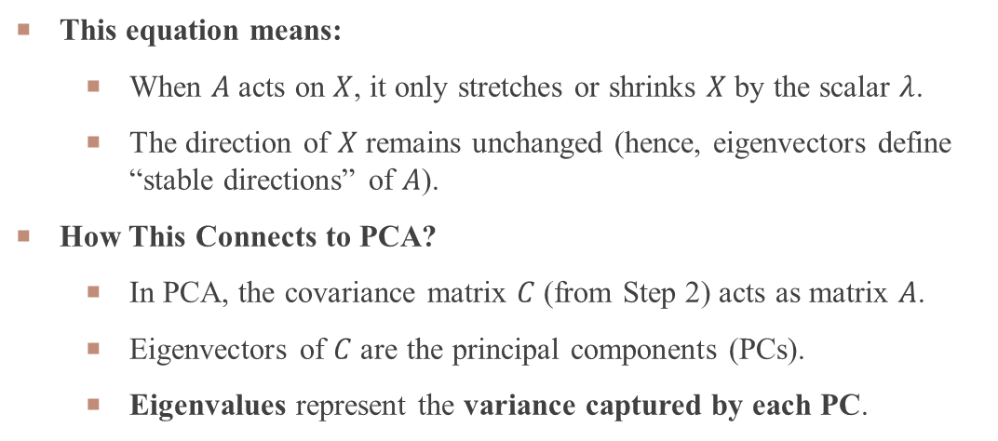
Step-by-Step PCA (Conceptual Outline)
Step3: Find Principal Components
PCA identifies new axes (like rotating a camera) where the data spreads out the most:
1st Principal Component (PC1): The direction of maximum variance (most spread).
2nd Principal Component (PC2): The next best direction, perpendicular to PC1, and so on.
These directions are calculated using Eigenvalues and Eigenvectors
Eigenvectors (math tools that find these axes)
and their importance is ranked by eigenvalues (how much variance each captures).
This equation means:
When $A$ acts on $X$, it only stretches or shrinks $X$ by the scalar $λ$.
The direction of $X$ remains unchanged (hence, eigenvectors define “stable directions” of $A$).
How This Connects to PCA?
In PCA, the covariance matrix $C$ (from Step 2) acts as matrix $A$.
Eigenvectors of $C$ are the principal components (PCs).
Eigenvalues represent the variance captured by each PC.

Slide 8
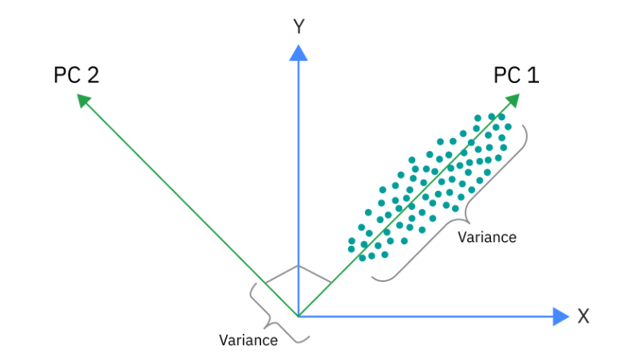
Step-by-Step PCA (Conceptual Outline)
Step 4: Pick the Top Directions & Transform Data
Keep only the top 2–3 PCs (or enough to capture ~95% of the variance).
Project the data onto these directions to get a simplified, lower-dimensional version.
The red dashed lines indicate the spread (variance) of data along different directions .
The variance along PC₁ is greater than PC₂, which means that PC₁ carries more useful information about the dataset.

Slide 9
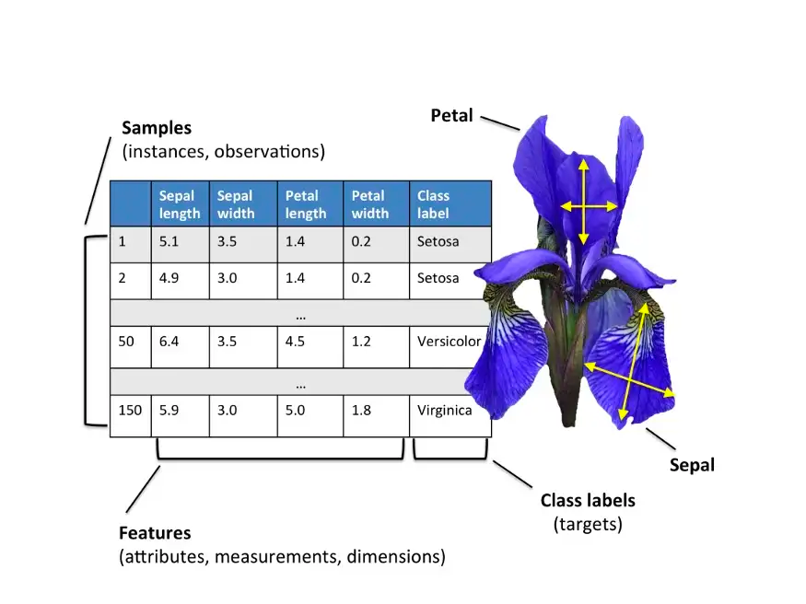
Example in R: Using the Iris Dataset
The classic iris dataset contains measurements of three plant species (Setosa, Versicolor, Virginica) across 4 features:
Sepal.Length,
Sepal.Width,
Petal.Length,
Petal.Width.

Slide 10
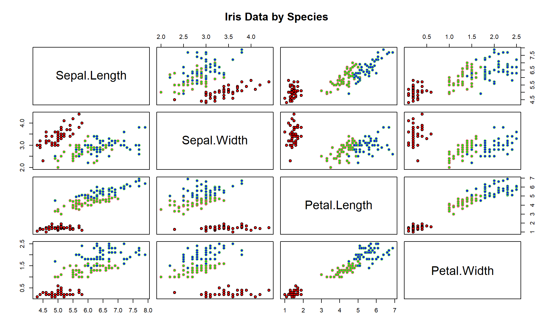
Example in R: Using the Iris Dataset
Check the correlation for four features
Sepal.Length,
Sepal.Width,
Petal.Length,
Petal.Width.
Flat trend means no correlation
High correlation for independent data means redundant information

Slide 11
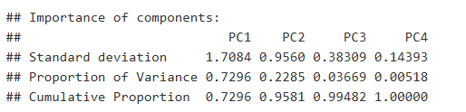
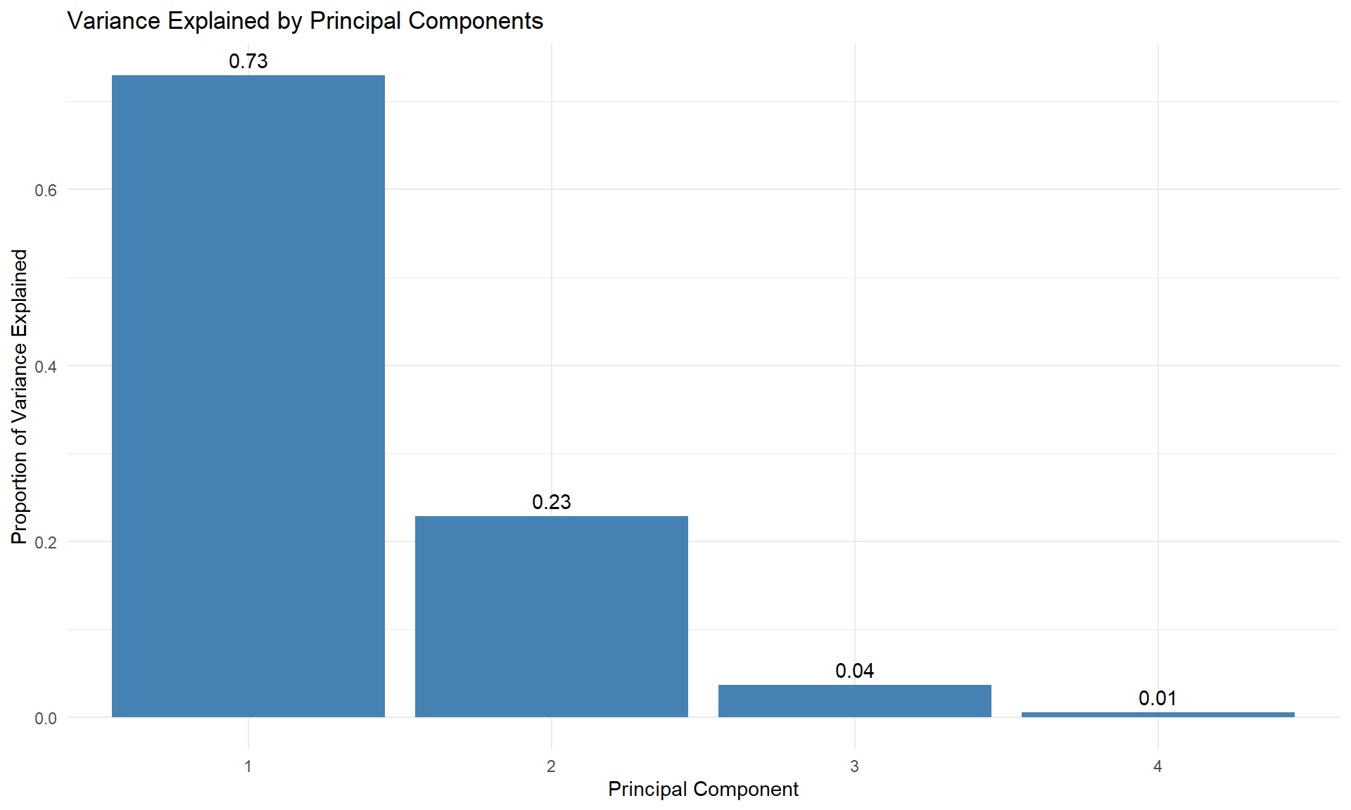
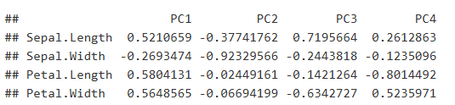
Example in R: Using the Iris Dataset
Perform PCA
Proportion of variance : Variance explained by this PC
Cumulative proportion: Variance explained by combination of PCs
Usually, we will use 95% cumulative proportion as the threshold for number of PCs
Interpret PCs
Check how much each original variable contributes to each principal component.
These loadings indicate the correlation between the original variables (Sepal.Length, Sepal.Width, Petal.Length, Petal.Width) and the Principal Components (PC1, PC2, PC3, PC4).
E.g. for PC1, Sepal.Length has a loading of 0.5210659, which is relatively strong.

Slide 12
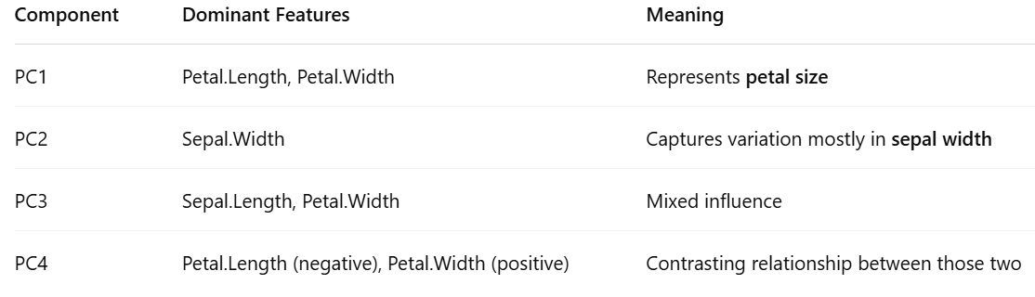

Slide 13
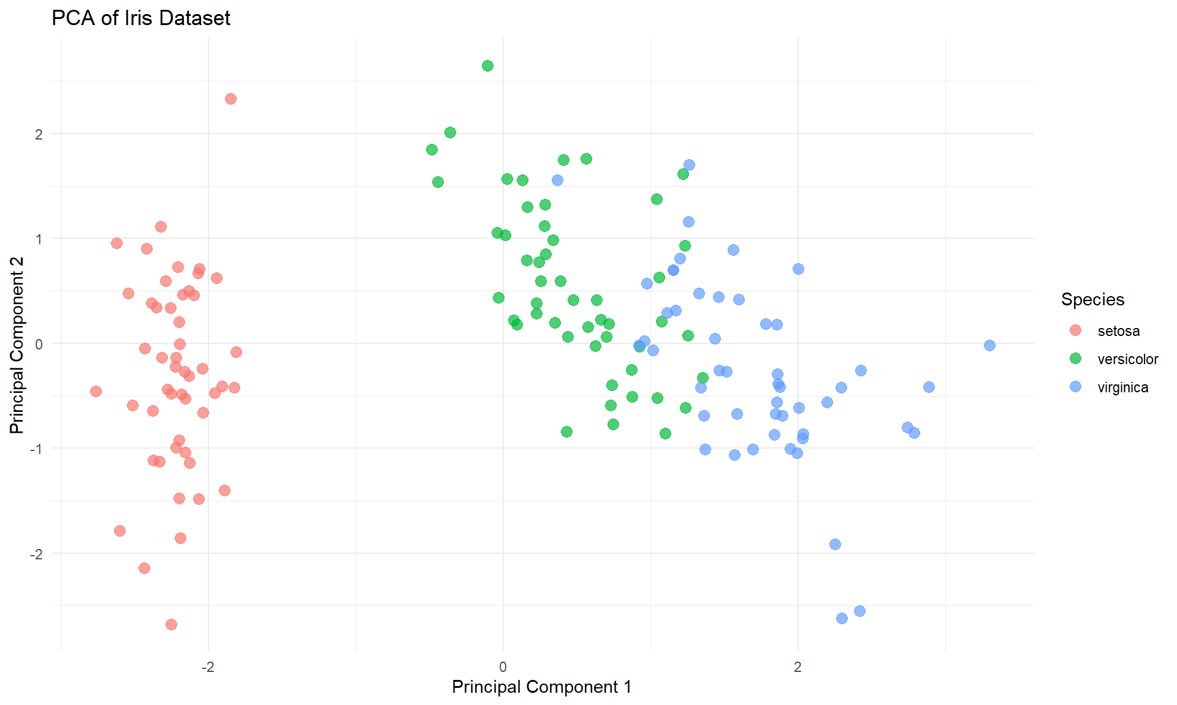
Example in R: Using the Iris Dataset
Dimension Reduction
Use 2 new variables (PC1 and PC2) to preserve 95.8% information from 4 features.
Although it’s not perfect boundary between versicolor and virginica, but setosa is easily distinguished in this 2D feature space.
Practical Tips and Cautions
Scaling: Always check if your variables have drastically different scales. If so, standardizing is crucial.
Outliers: PCA can be sensitive to outliers; large values can distort the principal components.
Interpretability: Principal components are linear combinations of original variables, which can sometimes be less intuitive than the original features.

Slide 14
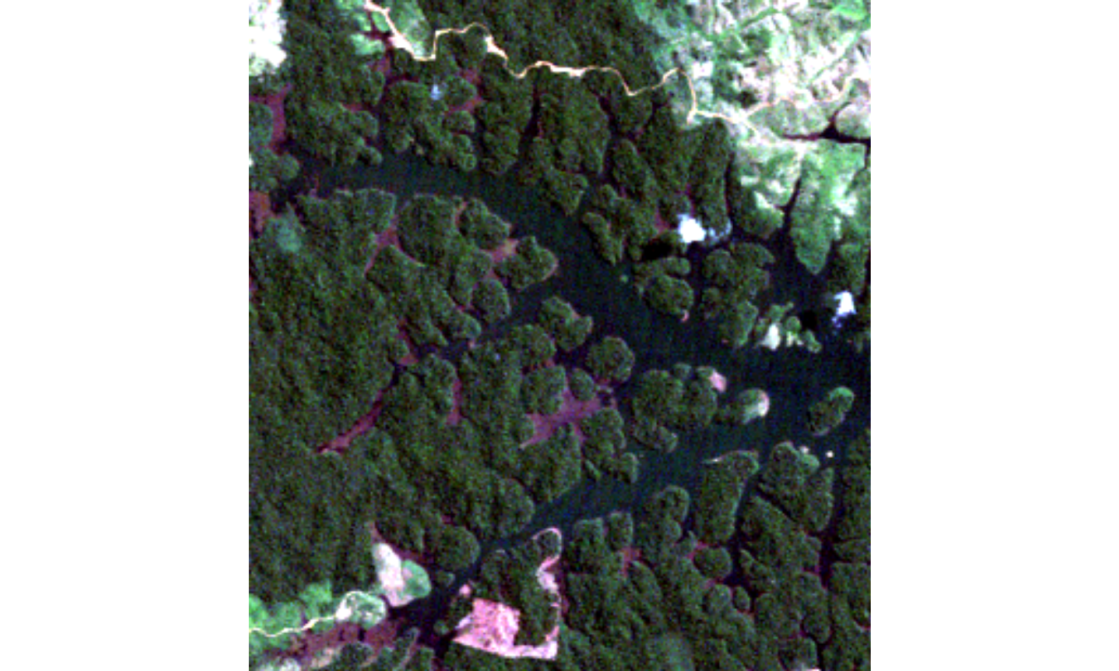
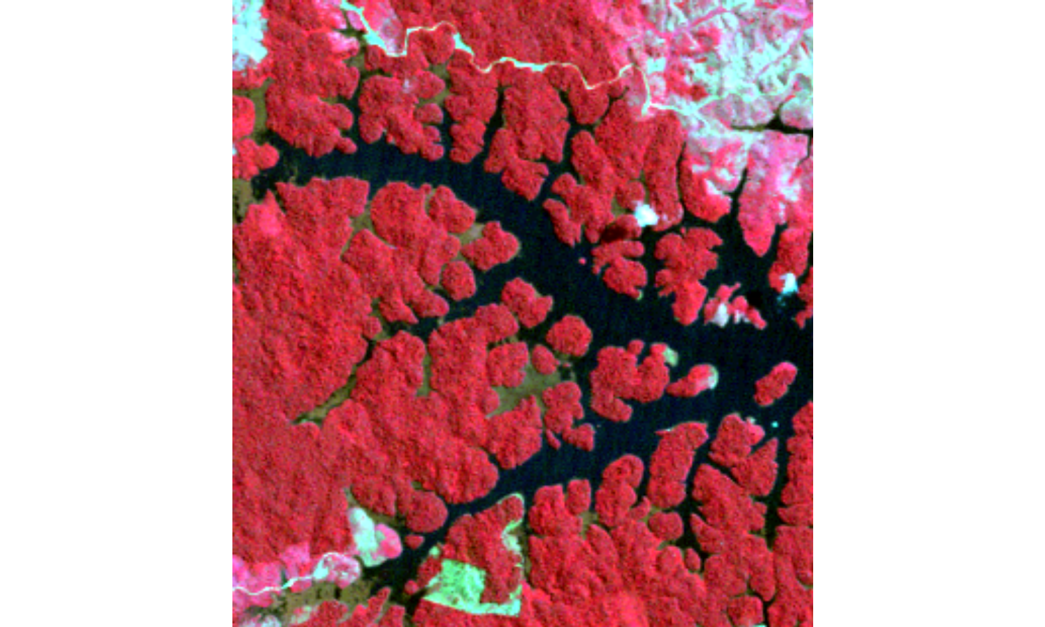
PCA FOR REMOTE SENSING
Nature of remote sensing data
Remote sensing data typically contains many bands (wavelengths) for each pixel, making it high-dimensional.
Each band contains different spectral information
Combine them can enhance certain features, e.g. NIR (highlights vegetation in red)
True Color Composite (3,2,1)
False Color Composite (NIR) 4,3,2

Slide 15
PCA FOR REMOTE SENSING
Band information for example data
Landsat 5 Thematic Mapper (TM)
Band 1 Visible Blue (0.45 - 0.52 µm) 30 m.
Band 2 Visible Green (0.52 - 0.60 µm) 30 m.
Band 3 Visible Red (0.63 - 0.69 µm) 30 m.
Band 4 Near-Infrared (0.76 - 0.90 µm) 30 m.
Band 5 Near-Infrared (1.55 - 1.75 µm) 30 m.
Band 6 Thermal (10.40 - 12.50 µm) 120 m.
Band 7 Mid-Infrared (2.08 - 2.35 µm) 30 m.
True Color Composite

Slide 16
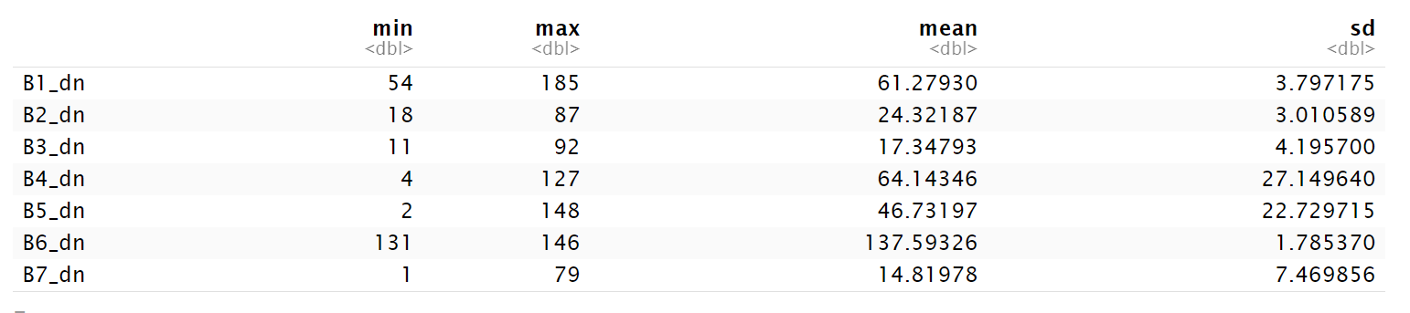
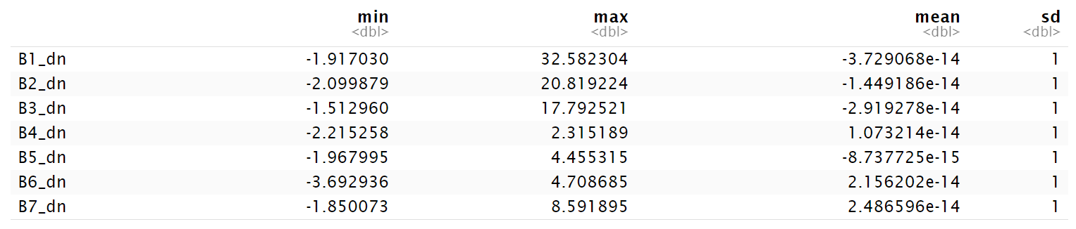
Standardized band in raster

Slide 17
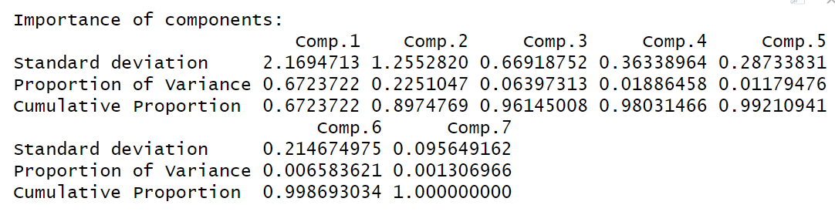
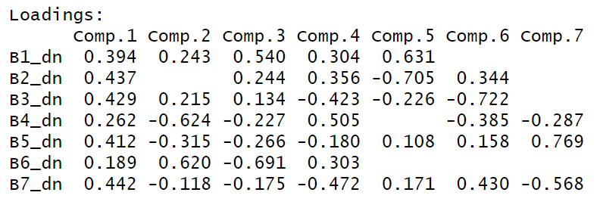
PCA FOR REMOTE SENSING
Perform PCA
96.14% information can be included into three new bands
Component 1 (Comp.1) dominates the variance, explaining 67.23% of the total variance, indicating it captures the most significant information in the data.
Interpretation of Result
Component 1 (Comp.1) is primarily driven by Band 4 (B4_dn) and Band 5 (B5_dn), suggesting it captures variations related to vegetation and soil moisture, as these bands are sensitive to those features.
Component 2 (Comp.2) is strongly influenced by Band 4 (B1_dn) and Band 5, indicating it may represent variations related to difference between healthy vegetation from stressed or drier areas

Slide 18
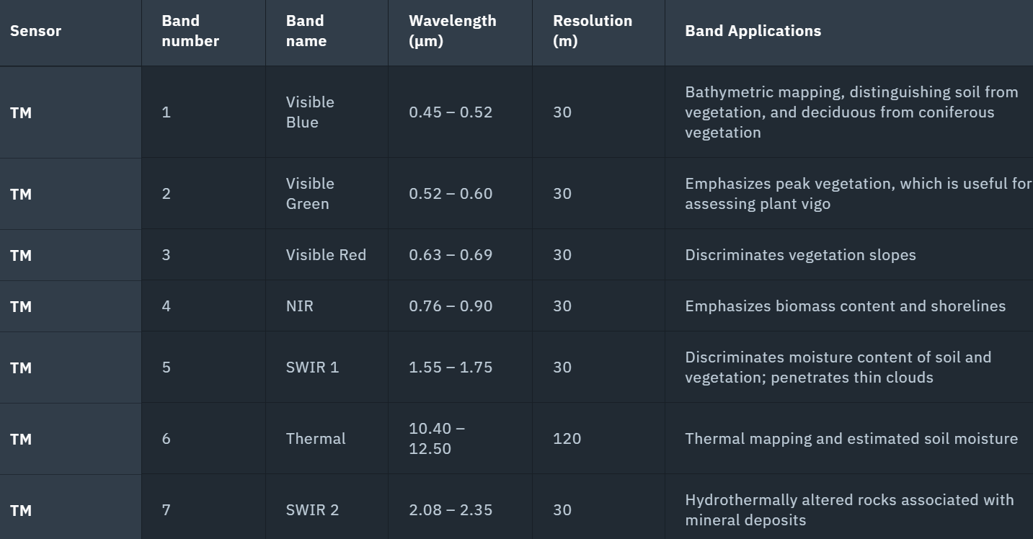
explanation
Comp.1 This component likely reflects overall brightness or vegetation/urban variations
Comp.2 It highlights moisture stress, urban heat vs vegetation, or bare soil vs green cover.

Slide 19
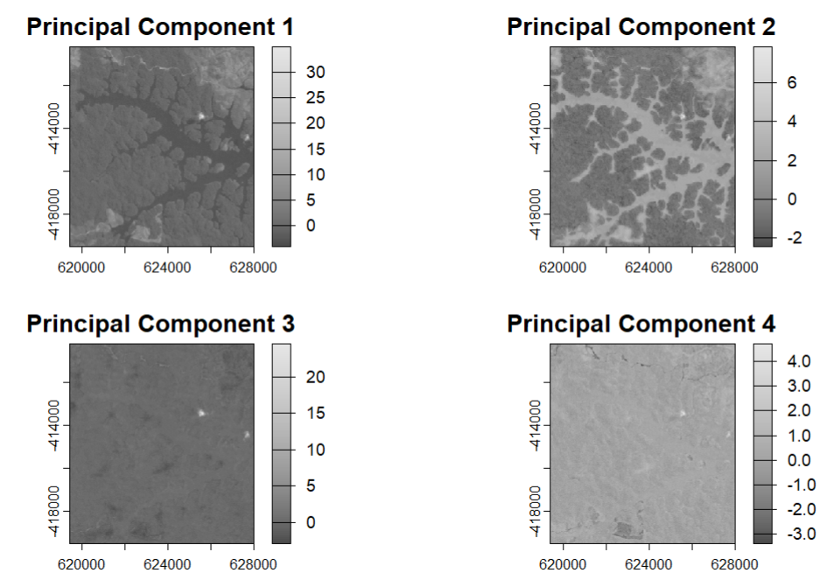
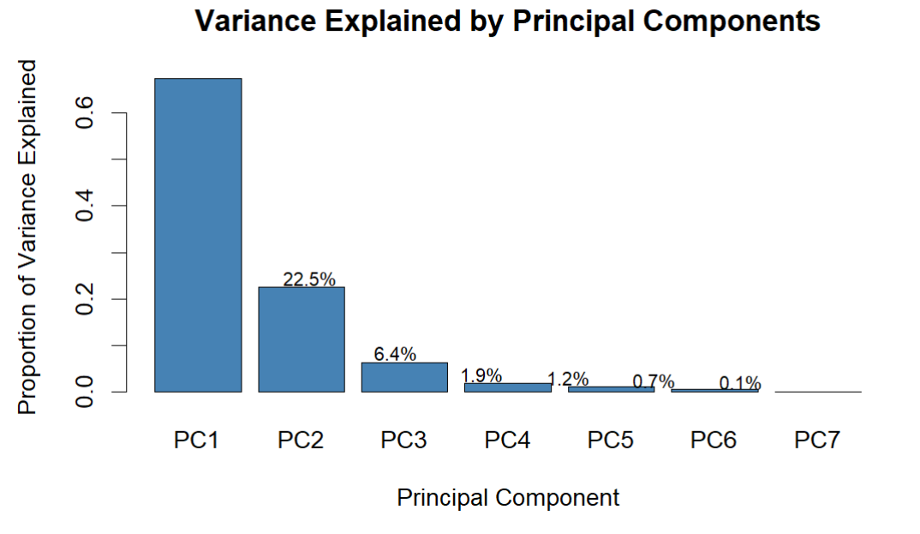
PCA FOR REMOTE SENSING
Visualize the PCA results
More variance, more details
Principal Component 1 (PC1) shows the most distinct contrast and detail. It clearly highlights the water bodies (dark areas) and the surrounding land features (lighter areas) with significant variation.
Principal Component 2 (PC2) still exhibits visible spatial patterns, but with less contrast than PC1. It shows some differentiation between land features, but the water bodies are less distinctly defined.

Slide 20
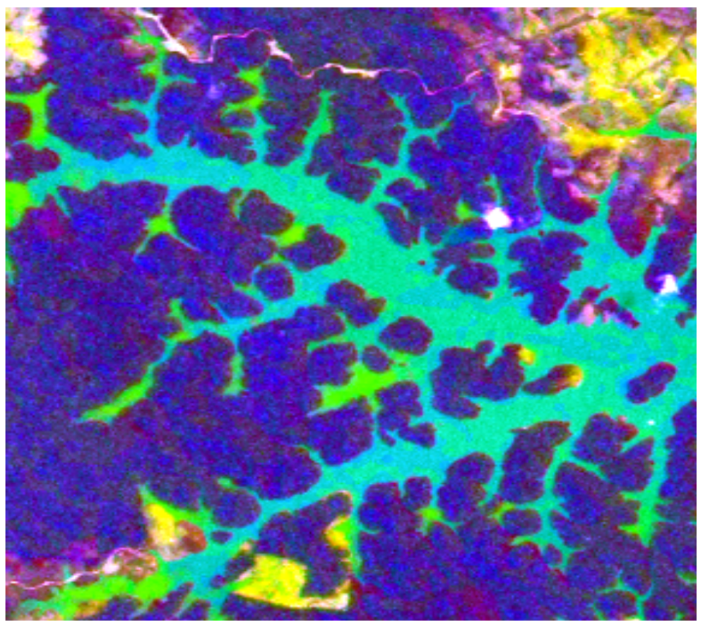
PCA FOR REMOTE SENSING
Create your own remote sensing index
PCA transforms multispectral remote sensing data into a new set of uncorrelated components that capture the most significant variations in the data.
These components can be used to create custom indices that highlight specific features or phenomena that might not be easily discernible using traditional band combinations. bodies are less distinctly defined.

Slide 21
PCA in remote sensing
https://www.researchgate.net/publication/259638444_Principal_component_analysis_applied_to_remote_sensing
https://www.asprs.org/wp-content/uploads/pers/1987journal/dec/1987_dec_1649-1658.pdf
https://www.nature.com/articles/s41598-024-75329-w?utm_source=chatgpt.com

Slide 22
WEEK 10 CODE DEMO session
Instructor: Yanan Wu
TA: Khadija Nisar
Spring 2025

